Slide 1
Analysis of Tuberculosis Affects on Different Countries
GROUP :
Sashank Addanki Venkata Naga
Rithik Rathinavel Ragupathi
Irfan Saleemudeen
Kalidindi Saketh Varma

Slide 2
Introduction
Why Tuberculosis?
A leading cause of death globally.
High burden in low- and middle-income countries.
Impacts public health and economic productivity.
Objectives
Understand TB trends over time and regions.
Identify high-burden countries.
Forecast future trends to guide interventions.
Highlights trends in prevalence, mortality, and incident cases.
Provides actionable insights for public health strategies.

Slide 3
Methodology and Tools used
Data Preprocessing: The dataset was first cleaned and preprocessed using SQL to handle missing values and ensure consistency.
Exploratory Data Analysis (EDA) & Statistical Analysis: by accessing the data frame from SQL we visualized data trends, distributions, and relationships to understand patterns of cases/deaths among the countries by employing various data analysis and visualization libraries such as Pandas, NumPy, Matplotlib, Scikit-learn, and Seaborn. Descriptive statistics were also calculated to summarize the data, and statistical methods, including correlation analysis and regression modeling, were employed to explore relationships between different variables.
LangChain and OpenAI: Used GPT models (e.g., GPT-4, GPT-3.5-turbo) for generating insights

Slide 4
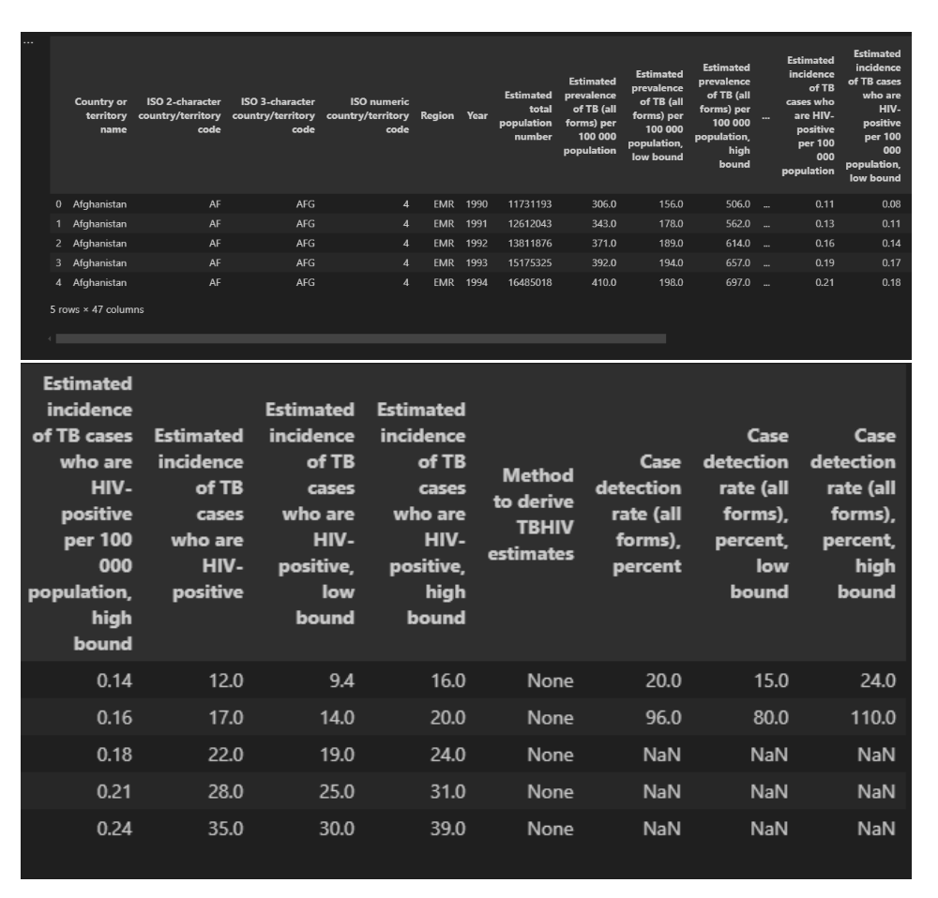
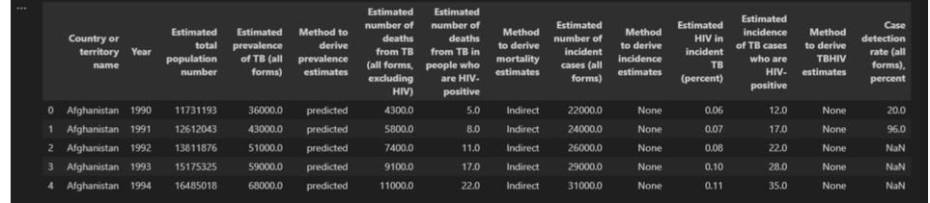
Verify the table creation by reading the data back

Slide 5
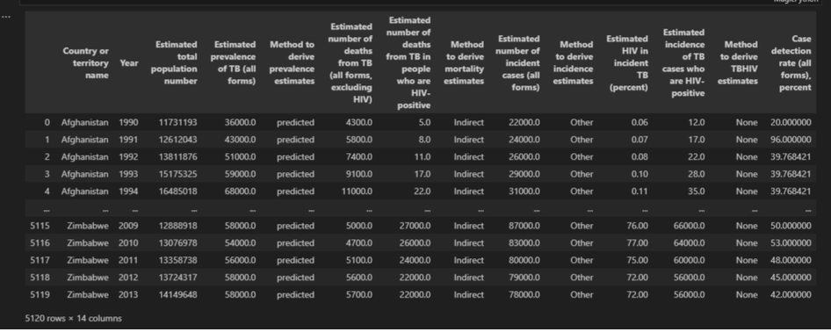
Handling missing values
The column method to derive incidence estimates has 2133 missing values out of 5120. So, we filled the missing values with the value “Other”.
And the column Case detection rate (all forms), percent has only 449 missing values. So, we have handled it by updating with the mean of each of its country
At the end we overwrote the existing table in SQL with the updated values.
Case detection rate (all forms), percent has only 449 missing values
so, we have handled it by updating with the mean of each of its country

Slide 6
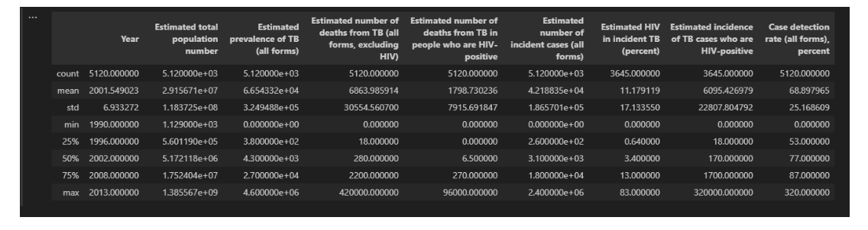
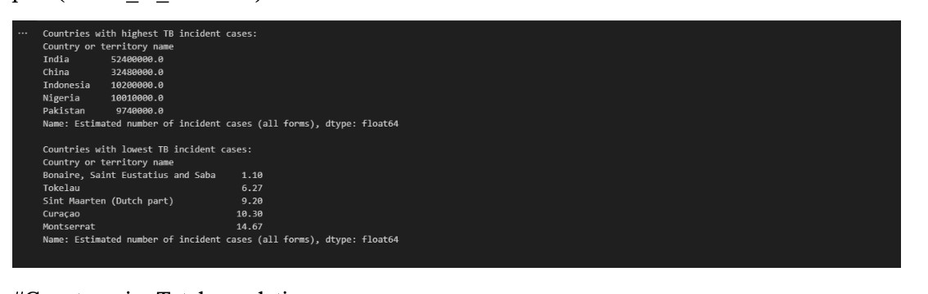
Summary Statistics: India, China, Indonesia, Nigeria, and Pakistan have the highest TB incident cases, indicating significant healthcare challenges.
Total TB incident cases:

Slide 7
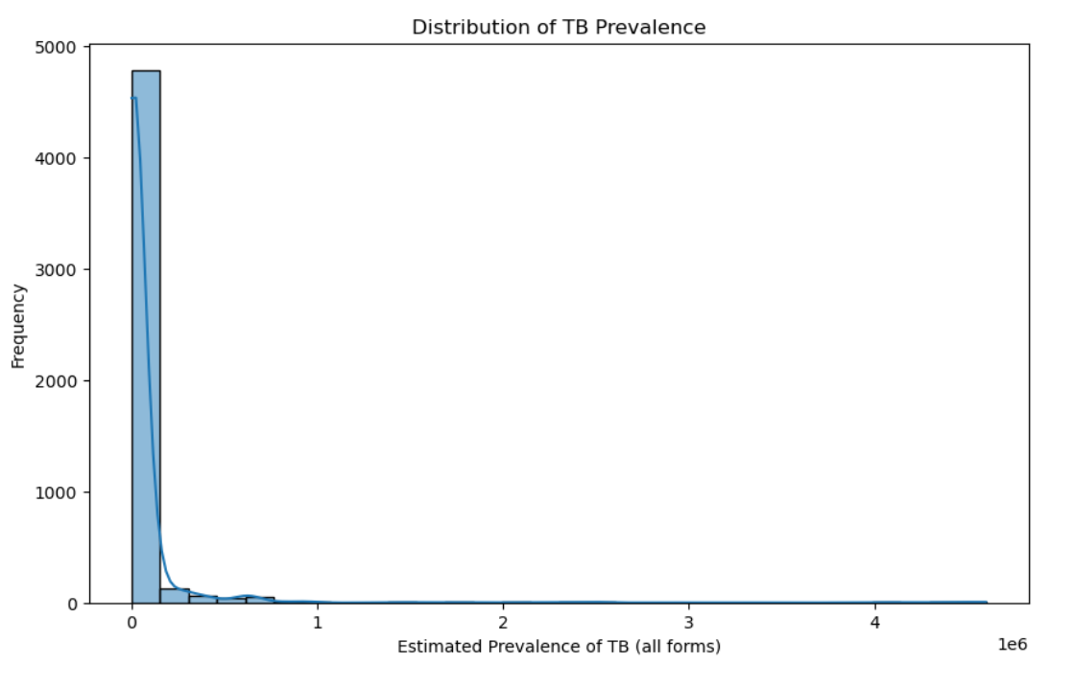
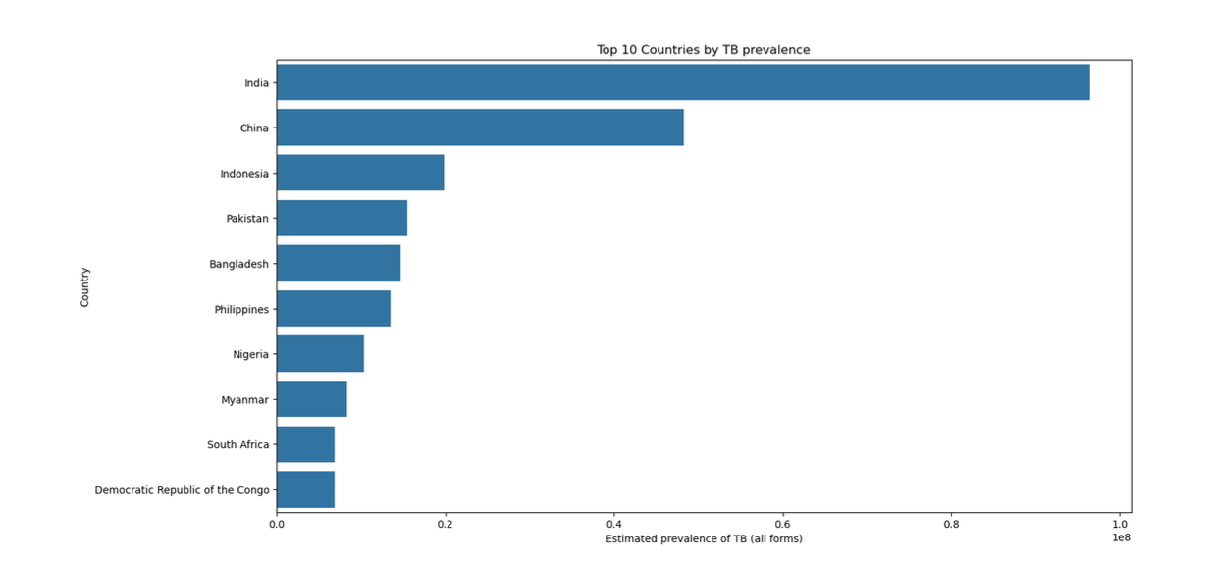
Distribution of TB Prevalence:
TB Prevalence:
India has the highest estimated prevalence of TB among the listed countries. The other countries following India in terms of high TB prevalence are China, Indonesia, and Pakistan.
The histogram highlights that most regions have a low estimated prevalence of TB, with only a few regions showing significantly higher prevalence.

Slide 8
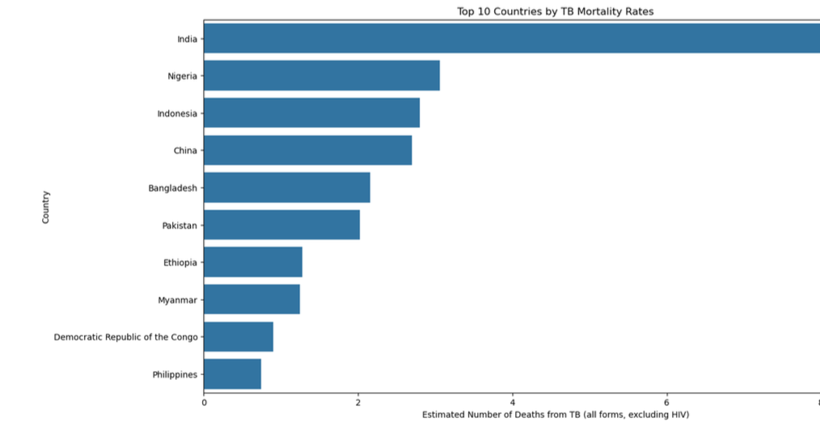
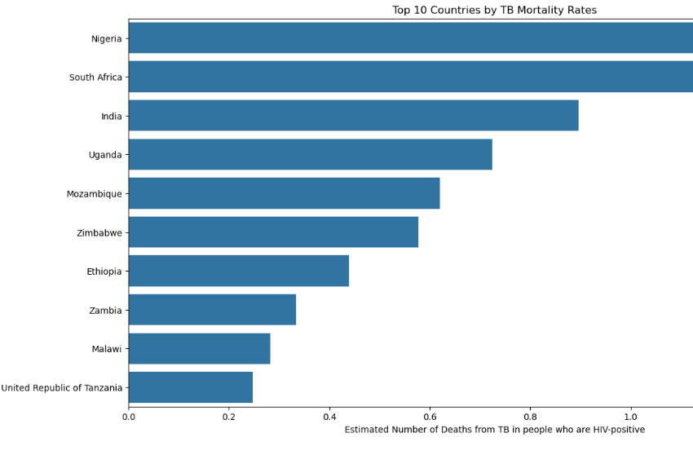
Mortality Rates by Country excluding HIV :
India stands out with the highest TB mortality rate.
Nigeria, Indonesia, and China also show significant numbers of TB-related deaths, indicating these countries require substantial public health interventions.
TB Mortality Rates by Country including HIV positive:
Nigeria has the highest number of deaths from TB among HIV-positive individuals, followed by South Africa and India. Uganda,
Mozambique, and Zimbabwe also have significant TB mortality rates.

Slide 9
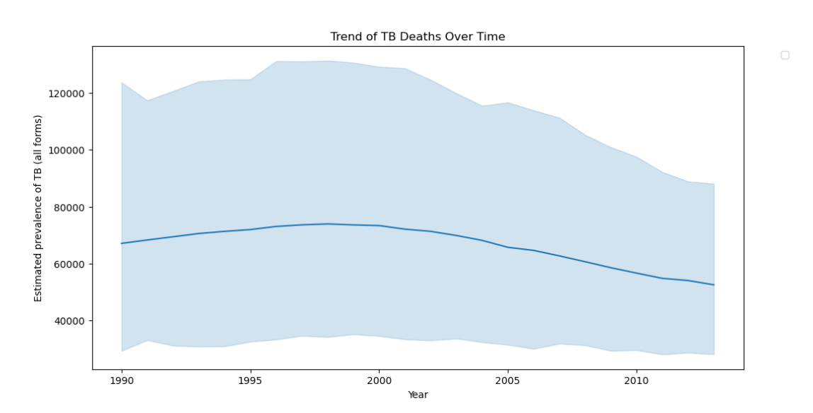
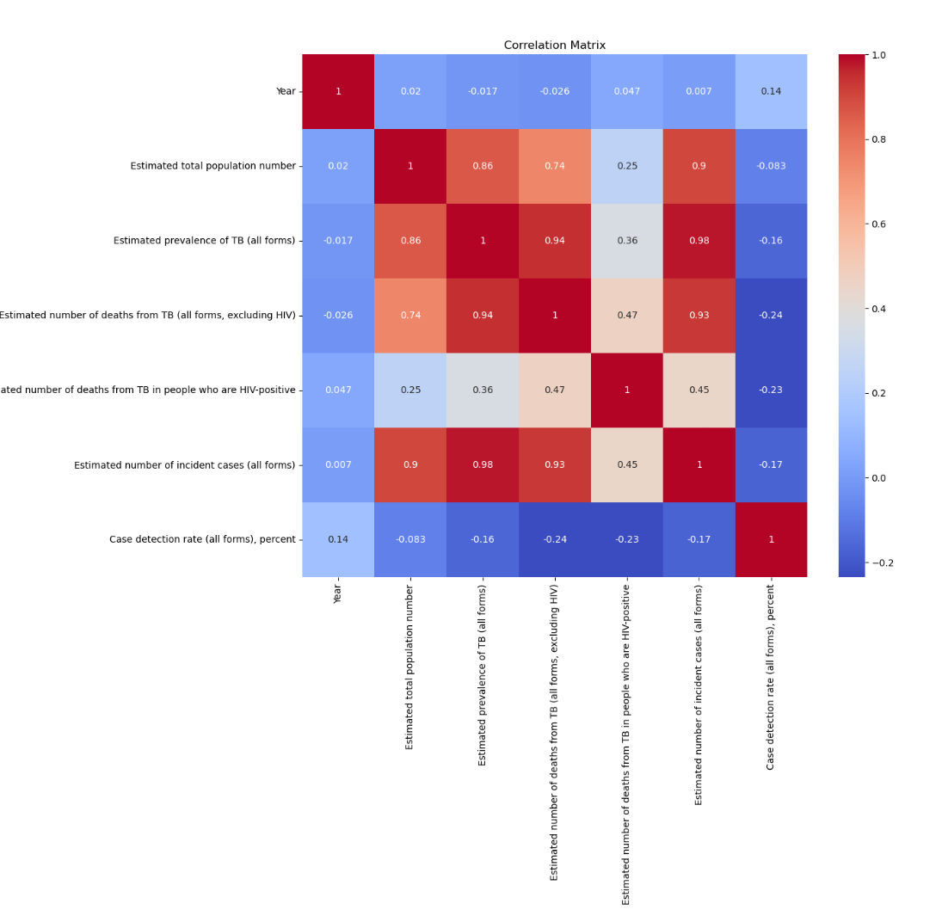
Correlation Analysis: the prevalence of TB increases, the incidence and mortality rates are likely to increase as well.
Global Trend Analysis Over Time:
The graph provides a clear visual representation of the trend in TB prevalence over the years, showing a peak in the early 2000s followed by a steady decline.

Slide 10
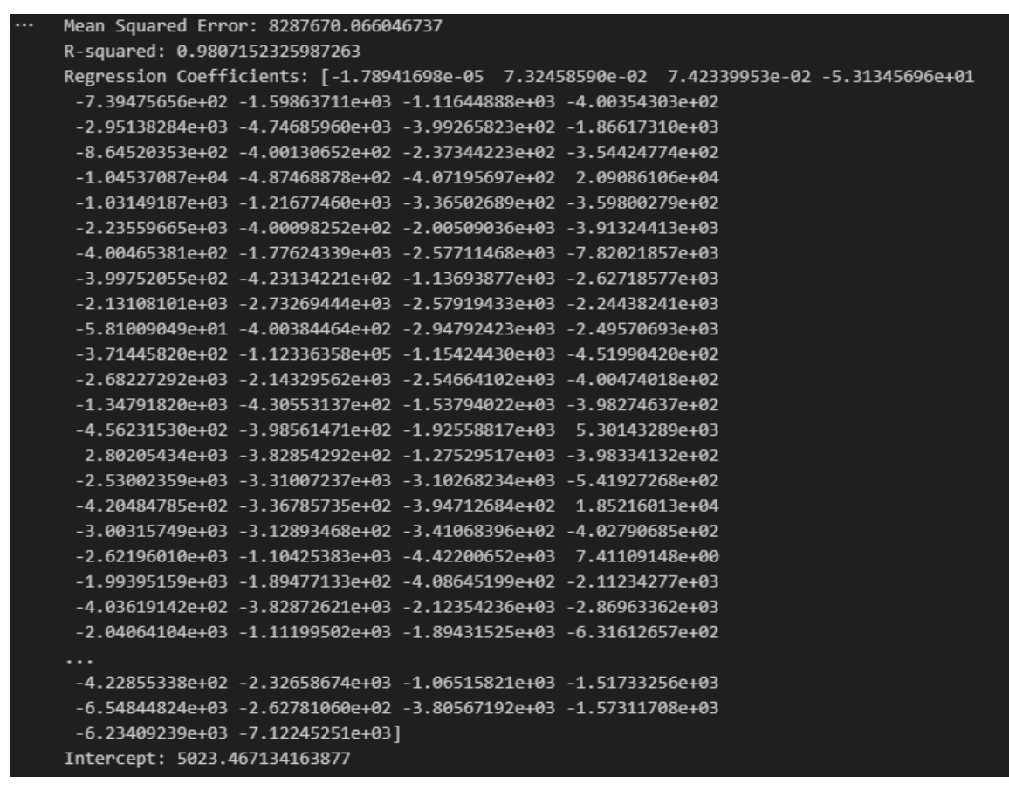
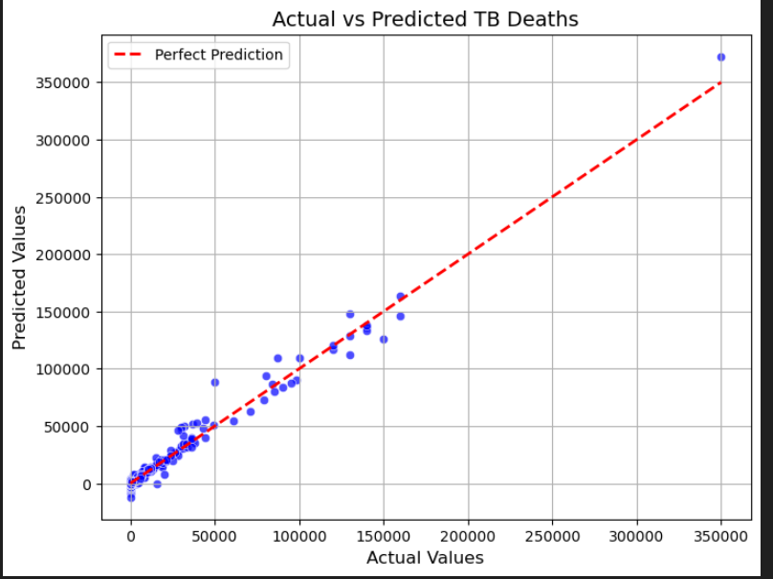
Multiple Linear Regression
Model Accuracy: The high R-squared value (0.98) indicates that the model fits the data very well. o
Error Margin: The MSE value (8287670.07) helps to understand the average squared error between the predicted and actual values.
Coefficient Impact: Each coefficient shows how each predictor variable affects the outcome. Positive values increase the outcome, while negative values decrease it.
Intercept: 5023.467134163877. This is the predicted value of the dependent variable when all independent variables are zero.

Slide 11
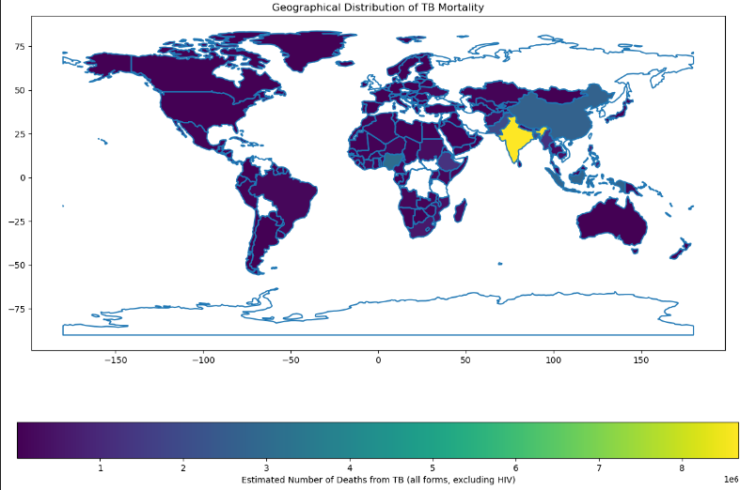
Geographical Insights:
High Mortality Areas (Yellow)
Moderate Mortality Areas (Blue/Purple Gradient)
Low Mortality Areas (Dark Purple)
TB mortality rates

Slide 12
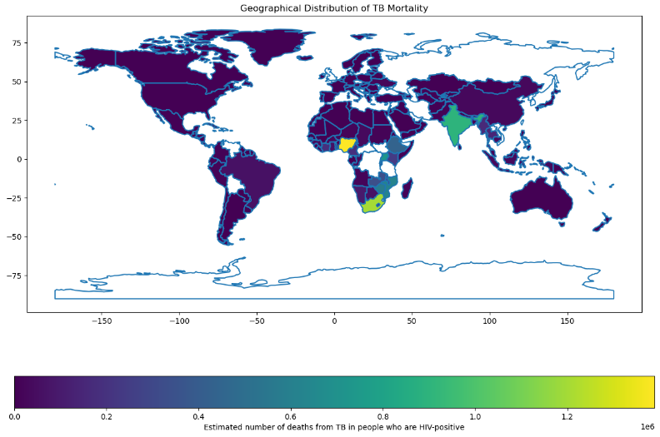
TB mortality

Slide 13
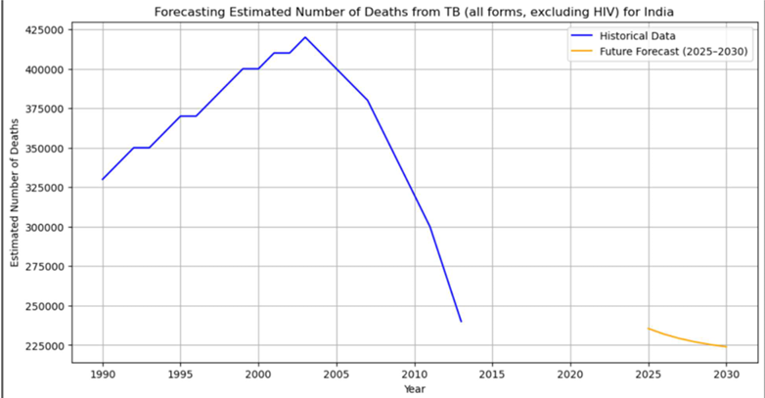
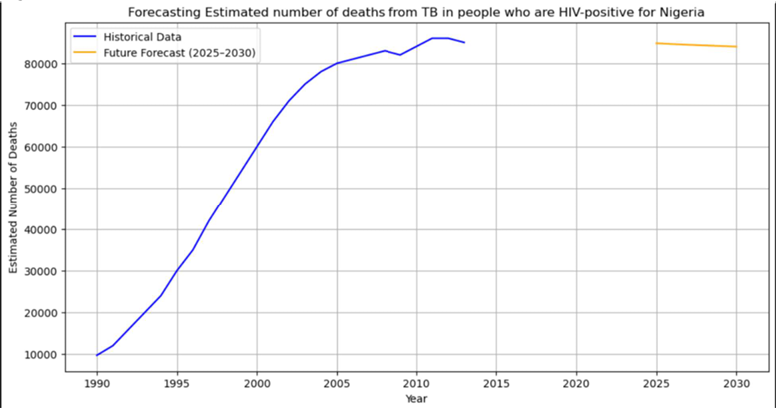
Future Forecast :
Death cases:
Predict a slight decrease in TB deaths in India from 2025 to 2030.
There is neither increase nor decrease in Nigeria(Figure 10) from 2025 to 2030.

Slide 14
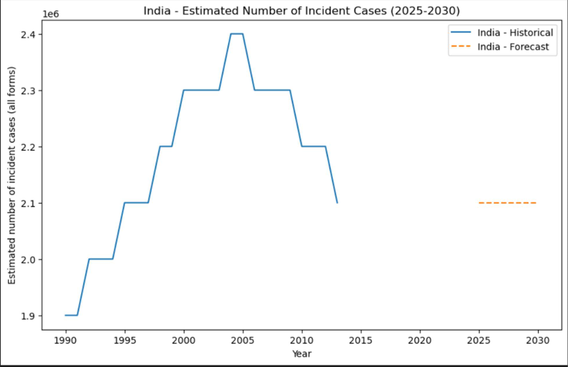
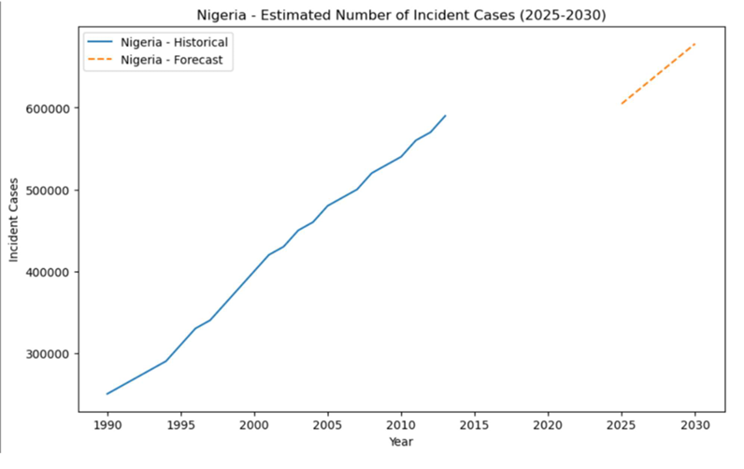
Future Forecast :
Incident Cases:
In India the number of cases from 2025 to 2030 seems to be at par with the number of cases registered in 2013.
In Nigeria steady rise in incident cases over the years.

Slide 15
Recommendations
Healthcare Investments:
Strengthen healthcare infrastructure in high-burden regions.
Enhance access to diagnostic tools and treatment facilities.
Policy Suggestions:
Implement national TB control programs focusing on early detection.
Ensure free or subsidized TB medications in vulnerable regions.
Research and Development:
Invest in vaccine development.
Promote studies on drug-resistant TB strains.
Collaborative Efforts:
Governments, NGOs, and private sectors must work together to combat TB effectively.

Slide 16
Thank You!!

